Slide 1
Compromise for Discussion (Draft)
Town of Malabar Trails and Greenways Committee is proposing this compromise for restoration of Malabar East and West, with the goal of:
To the largest extent possible, allow the EELp to continue to manage the property for their overall environmental goals, and
Maintain the best trail user experience possible, and
Address immediately adjacent homeowner concerns where possible.
This is a “trails centric” recommendation that is considered within the consideration of the Malabar G&GC. It does not address other areas that the overall Town of Malabar may wish to consider. Such as:
Removal of trees in the areas away from the trail
Additional trees at the boundaries with local homes
Modifications near the creek in Malabar West, and/or depression marshes in Malabar East

Slide 2
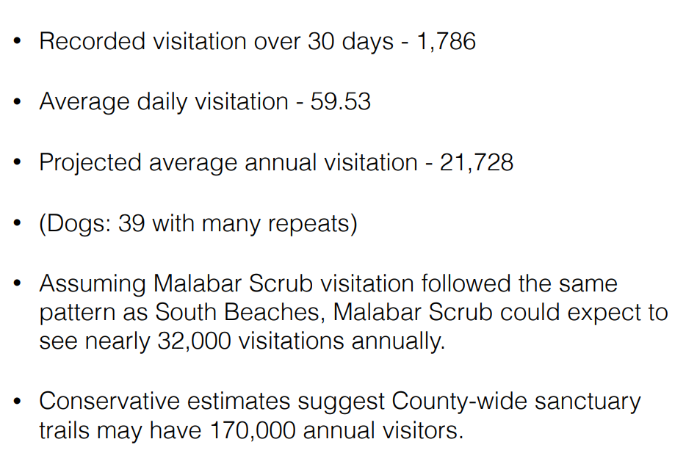
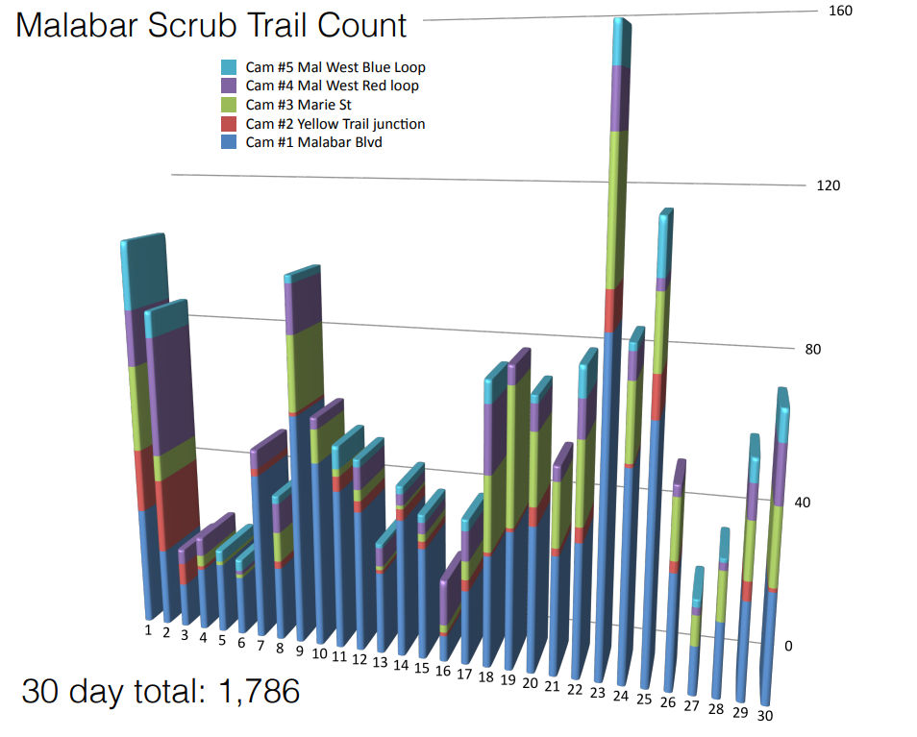
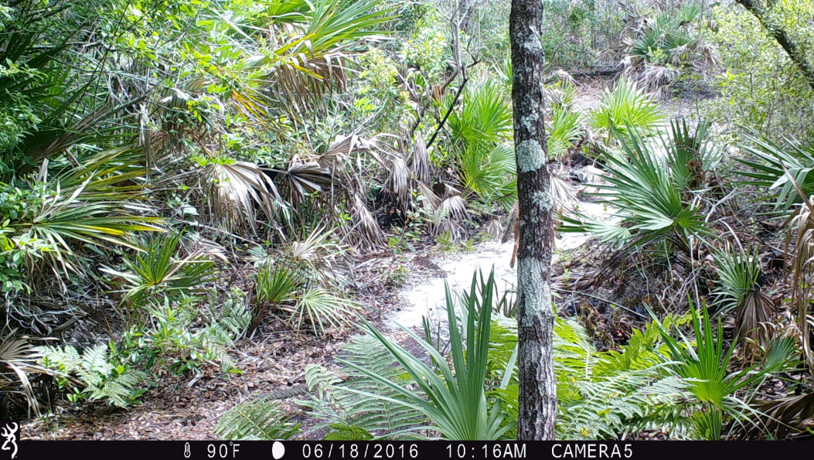
EEL Program Trail Count for Malabar Scrub Sanctuary from June 2016 (summary)
Estimate is trail usage has more than doubled since that time – this is a VERY important trail property for Brevard County and an excellent urban forest

Slide 3
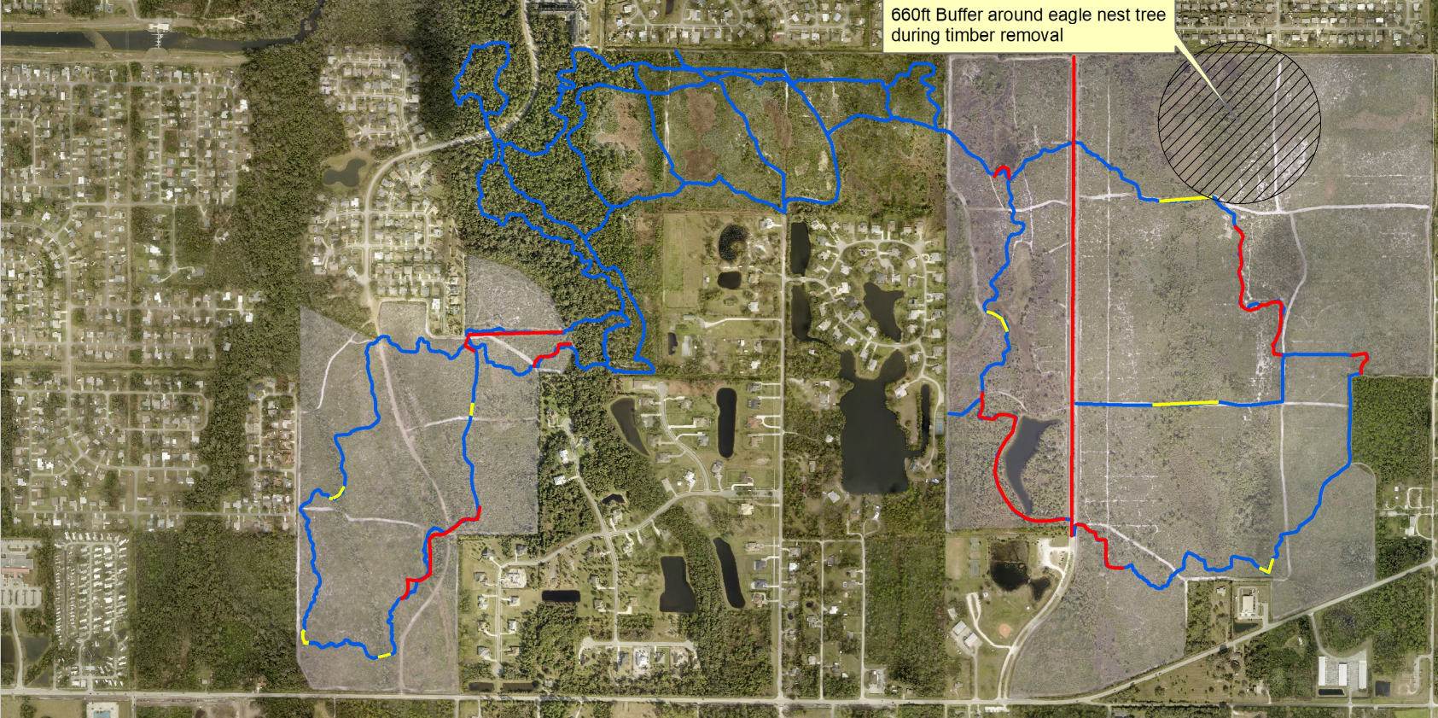
EELs Restoration and Trail Map

Slide 5
Malabar West
The next two pages discuss Malabar West, and the distances to “screening trees”
The EELp has identified a goal of maintaining 1000’ to any screens of trees, to help promote more optimal scrub habitat
We have been unable to find this 1000’ number elsewhere, but we have found both 300’ (Florida Fish and Wildlife), and several sources that quote 136M (450’), so this was also analyzed at 500’
In most areas, screening trees occur already at the entire property boundaries, so an analysis was done of the property boundaries (i.e. trees on private property at property boundaries) to see the effects of 1000’ and 500’ offsets.

Slide 6
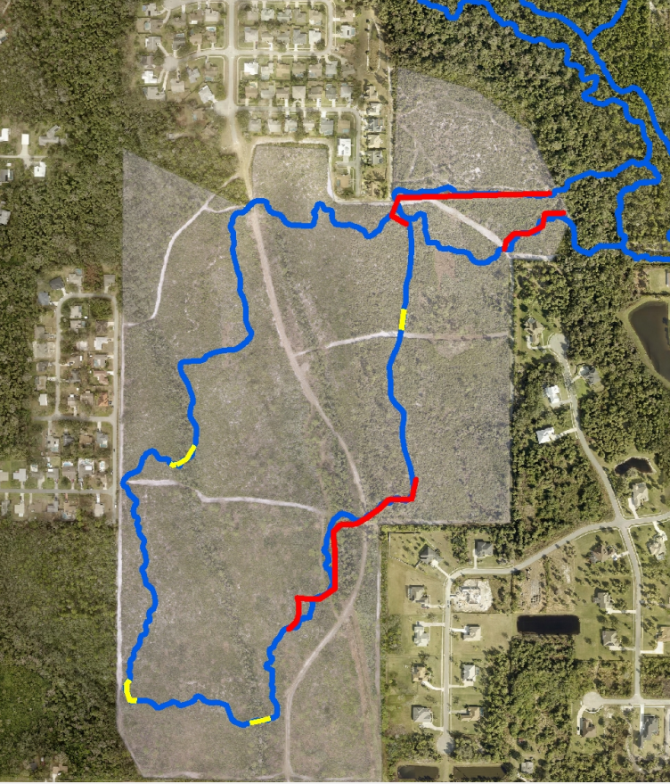
Malabar West
“1000 Feet to Screening Trees” Analysis
Green Arrow on Map Represents 1000’ to property boundaries and/or tall trees
1000’
Projection of each property boundary by 1000’ shows total overlap. This property has 0 area that meets the “optimal” Condition, not even accounting for the wetland creek that flows through the property, which adds an additional screen of trees.
1000’
1000’
1000’

Slide 7
Malabar West
“500 Feet to Screening Trees” Analysis
Green Arrow on Map Represents 500’ to property boundaries and/or tall trees
500’
Projection of each property boundary by 500’ shows a small area in the property center that is left. It is dominated by a drainage creek that feeds Turkey Creek channel D, and the Malabar ROW for Briar Creek Blvd (100’ wide, property of Town of Malabar).
500’
500’
Drainage Creek
Briar Creek Blvd ROW (Town of Malabar)
500’

Slide 8
Conclusion of 1000’ and 500’ Analysis
Malabar West is too small and complex in shape, and not appropriate to “optimize” the scrub based on the “screens of trees” criteria
1000’ analysis: Zero property left
500’ analysis: Small, complex area dominated by Malabar Owned ROW and Turkey Creek channel drainage creek.
Note: Assuming the EEL program should seek specific permission from the Town of Malabar to modify Town of Malabar owned property.
The ROW is 100’ wide and goes throughout the center of the property. Gates on both ends were built and are owned by Malabar. Most tall trees were removed from the ROW during the 2014 restoration.
Note: The creek that runs through this property directly feeds Turkey Creek channel D and the Indian River Lagoon and is a critical drainage for the Town of Malabar.
The Town of Malabar maintains this drainage (example: replaced the drainage pipes that cross under Briar Creek blvd in 2015).

Slide 9
Malabar West
Malabar West has an established trail compromise. We propose to build on that compromise while also recognizing that the EELp wishes to have overall fewer “screening” trees of greater than 15’. Within Malabar West, in general:
Maintain consideration of the “Trail Buffer” that is +/- 25’ of the trail
Within the Trail Buffer, remove all sand pines, remove taller pine trees as necessary, and remove scrub oaks greater than 15’ except for the areas specifically delineated, keeping all scrub oaks less than 15’.
Discussion: Everything we read indicates that trees of less than 15’ are OK. Elsewhere, EELp has roller chopped or mowed scrub oaks down to 4-6’. We do not see that this is necessary, but in particular we wish to see a different treatment near the trails.
Outside of the trail buffer, manage the property as you see fit, with the exceptions of:
Specifically delineated areas noted on the next pages
Some trail modifications are suggested, as a “win-win” scenario, with the goal of both advancing the EELp environmental goals, and enhancing the trial users experience.
There is some precedence for this. When the State of Florida Forestry did a major restoration on the Cross Florida Greenway, it started out with a “trail optimization” effort, to move trails away from prime scrub to areas where the land managers were more willing to leave more woods and taller overstory. References can be provided.

Slide 10
Malabar West
Overall
Malabar West Area “A”
Discussion: This is one of the last areas left that is unmodified from the original trail buffer compromise.
Compromise: Request minimal tree overstory removal in this area, removal of sand pines or particularly tall pines, but no removal of scrub oak overstory, for the following reasons:
About half of this trail length shown is crossing a wetland and Turkey Creek channel D, and is a much different habitat. In general, we understood that a 25’ buffer should be maintained to this creek.
It is tucked against Stillwater Preserve, which also provides a line of “screening trees”, and tree removal here does not really advance your management goals to get higher distance to screening trees.
Stillwater Preserve has expressed concerns with tree removal in this area
It provides trail users with a brief section that looks and feels like deep woods, after a long and largely exposed walk/ride South down the trail section above, which is largely exposed to the sun
A

Slide 11
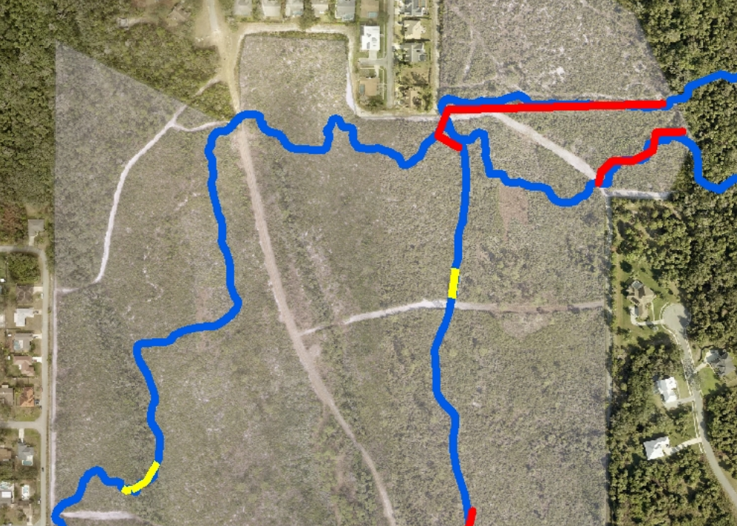
Malabar West Area “B”
Discussion: This area habitat is transitioning to habitat of the Turkey Creek channel area. It is currently not very tall scrub anyway, and as a trail user you can feel this unique transition from scrub to deep woods habitat.
Compromise: Request minimal tree overstory removal in this area, for the following reasons:
This area is transitioning to the deep woods habitat, and transitions to live oaks and palms
This are is tucked into a small “pocket”, and does not significantly advance the environmental goals of the program to increase distance to screening trees (this “pocket” is about 100’ across).
This area is one of the better trail experiences, experiencing that transition to the deep woods.
Scrub oaks are not particularly tall in this area (15’ish feet)
Southern portion is a location where local photographers take “ideal Florida” pictures. This is a favorite trail section of most trail users.
B

Slide 12
Malabar West Area “C”
Discussion: Habitat in the C area is also transitioning to the Turkey Creek river bottom type area, and more importantly provides an important connector to the N-S wooded area that separates the City of Palm Bay from Brook Hollow subdividion. It provides an important game corridor for animals. It is transitioning to the creek habitat to the North. This area offers an excellent opportunity to relocate a trail that would benefit both trail users, and the EELp environmental goals, but moving a trail out of a more prime scrub habitat to a habitat that is not prime habitat, making the central area of prime scrub habitat larger.
Compromise: Request minimal tree overstory removal in area “C”, just removing sand pines as necessary, taper edge down to fire break, removal of tall pines on fire break, and some Fecon thinning:
This area is important connectivity to, and similar to, the property to the North
Provides an important game corridor looking at the overall map
This area is never going to be prime scrub habitat, and it would be better used by trail riders, shifting a trail from prime habitat to less prime habitat
End result of relocating the trail provides a larger prime scrub habitat and relocates the trail to a non-prime area that will also provide a better experience for the trail user. Win win.
C
Shift trail from prime scrub habitat to lesser habitat, and only minimally restore that location

Slide 13
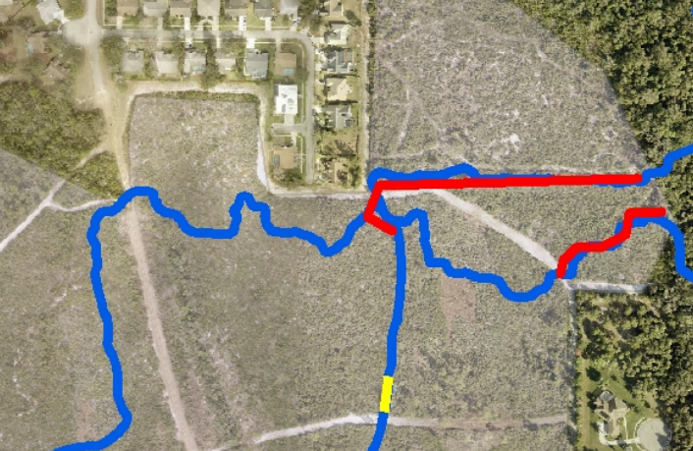
Malabar West Area “D”
Discussion: There are a few beautiful mature scrub oaks in this area that serve as a shade break and rest area from a largely shade-free run up from the South. It also serves as a small treed buffer against Brook Hollow (some of the only historic scrub oaks left that used to dominate this area).
Compromise: Request minimal tree overstory removal in area “D”, just removing sand pines, dead scrub oaks and excessively tall pines if needed:
Small buffer against Brook Hollow
Leaves some of the historic scrub oaks where Brook Hollow residents can see and enjoy them – Brook Hollow has an unofficial entrance nearby that is used by evening walkers everyday.
Provides trail riders a very short shade break at this trail intersection
Does not significantly affect the environmental goals of the program – it is a very small area located on the edge of the property
D
Leave mature scrub oaks at this small trail junction area

Slide 14
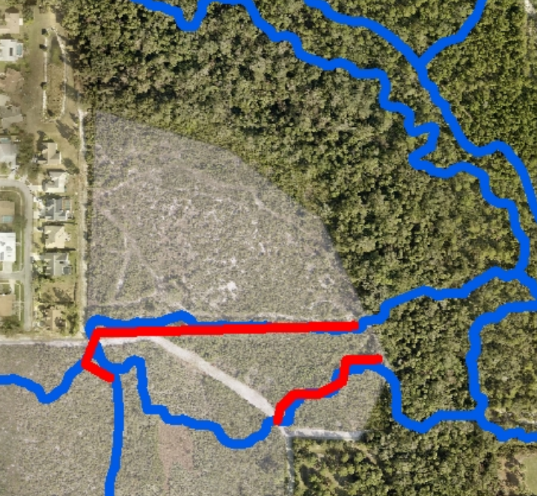
Malabar West Area “E”
Discussion: E-W trail that moves uphill in this area is a mess. After the last restoration, there were many piles of trees in the area (~14). Some of those piles caught fire (a possible arson), and the fire fighting plows went down about half of this trail. The trail has never been an ideal trail, and historically there was another trail along the bank of Turkey Creek Channel D that went fallow after 2004 hurricanes. This is possibly a long-term goal, but there is a possible win-win scenario, by shifting the trail to deep woods habitat, and running back in along the edge near brook hollow fire break (already a non-ideal edge area), both trail users and the EELp environmental goals are advanced
Compromise: Request shift of trail shown to approximate location shown
This trail was historically there but dead ended and was not re-opened after the 2004 hurricanes
Possible win-win for both trail users and EELp environmental goals – allowing larger prime scrub habitat not interrupted by trails
Result provides a larger prime scrub habitat and better trail user experience
E
Shift trail from prime scrub habitat to lesser habitat – improving management goals and Trail User experience – win-win

Slide 15
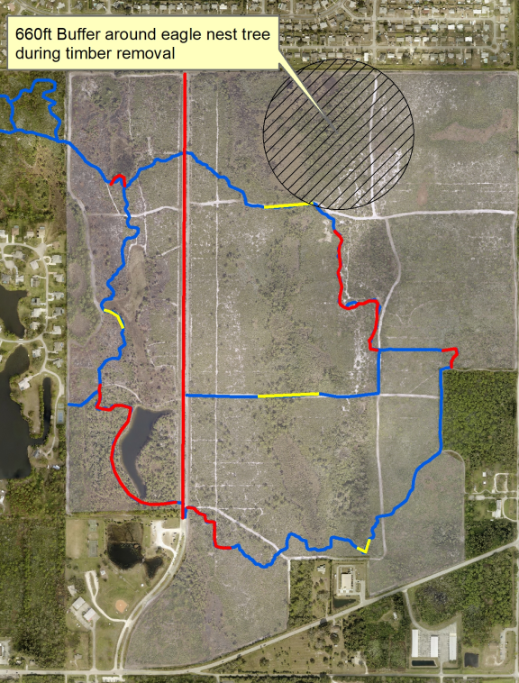
Malabar East
Overall
Malabar East Area “A”
Discussion: This small oak hammock was negotiated to be left, specifically for a small spot of “historic woods”, a hammock of scrub oaks, prior to a previous restoration (see next page for photo from 2001, nearby this location). It is small (possibly 100’ in diameter), and of little overall consequence to the EELp environmental goals, and we often see Scrub Jays in the understory of this area.
Compromise: Request minimal tree overstory removal in this area, just removal of sand pines and the taller pine trees, for the following reasons:
We often see Scrub Jays in this area. They seem to take refuge in the understory of the Scrub Oaks.
It is a small area. It has been suggested that a grouping of trees, if small enough, is no different than a single tree
It is near the property boundary to the N and W
It is all that remains of a much larger Scrub Oak forest – the trail was re-routed into this small oak hammock back in early 2000’s.
It provides trail users with a break of shade, after a long and largely exposed walk/ride throughout the rest of the sanctuary. It is a place to stop when overheating.
Leave the scrub oak hammock as is
A

Slide 16
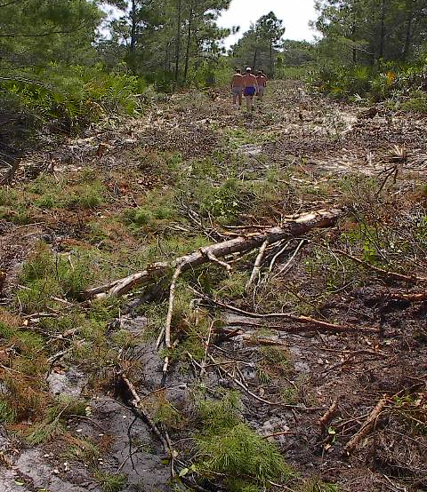
Nearby Location from 2001

Slide 17
Malabar East
B
Leave N boundary Live Oaks and large Scrub Oaks
Malabar East Area “B”
Discussion: Live oaks on far north property edge. There are several very large, mature oak trees along the N boundary (most of them N of the current fire brake), most of these trees are already N of the fire break. These trees can be left with little affect on the program environmental goals – and provide a visual break with the large urban area to the North.
Compromise: Request oak trees on North boundary be left, for the following reasons:
North edge of property (back property power lines are 30’ away to the N)
Provides a visual break between urban areas
Provides trees near the pave Al Tuttle trail just N of this boundary

Slide 18
Malabar East
Leave boundary inside of Fire break on E side of Country Cove
Malabar East Area “C”
Discussion: The fire break along most of Country Cove, to the east, is inside the property boundary due to this area being dominated by 3 different depression marshes.
This wooded area provides a natural buffer between Country Cove and the rest of Malabar Scrub Sanctuary East. This should be left as-is to prevent damage to the depression marsh areas, and to maintain the experience for Country Cove homeowners
Compromise: Request this area be left as-is
This is a narrow edge on the property boundary, and does not affect the environmental goals of the program
Area dominated by wetlands (this is why the EEL program chose to move their fire break away from the property boundary)
Provides a visual break for Country Cove homeowners
C

Slide 19
Malabar East
Malabar East Area “D”
Discussion: This is largely a palm and live oak hammock, that is probably left over from an old farm. It is a very wet area. It provides a good trail user experience. A small amount of this could be left against the Al Tuttle Trail (A Brevard County Showcase Trail), and encompass part of the off-road trail, significantly enhancing the trail user experience with minimal affect on the EELp environmental goals – please see photo on next page.
Compromise: Request minimal tree overstory removal in this area, just removal of sand pines, for the following reasons:
Enhance both the Al Tuttle Trail and the off-road trails by leaving a small area of woods
This is on the very edge property of the property and will have minimal affect on the overall goals of the program – tall trees exist immediately adjacent to this location just 15’ away
Small area overall
Wet area that will never be prime scrub habitat
We understand that this N-S trail is through prime habitat and can affect areas to both E and W, but would appreciate consideration of a few trees where appropriate
Minimal removal in this area, to support both the Al Tuttle trail and the off-road trail
D

Slide 20
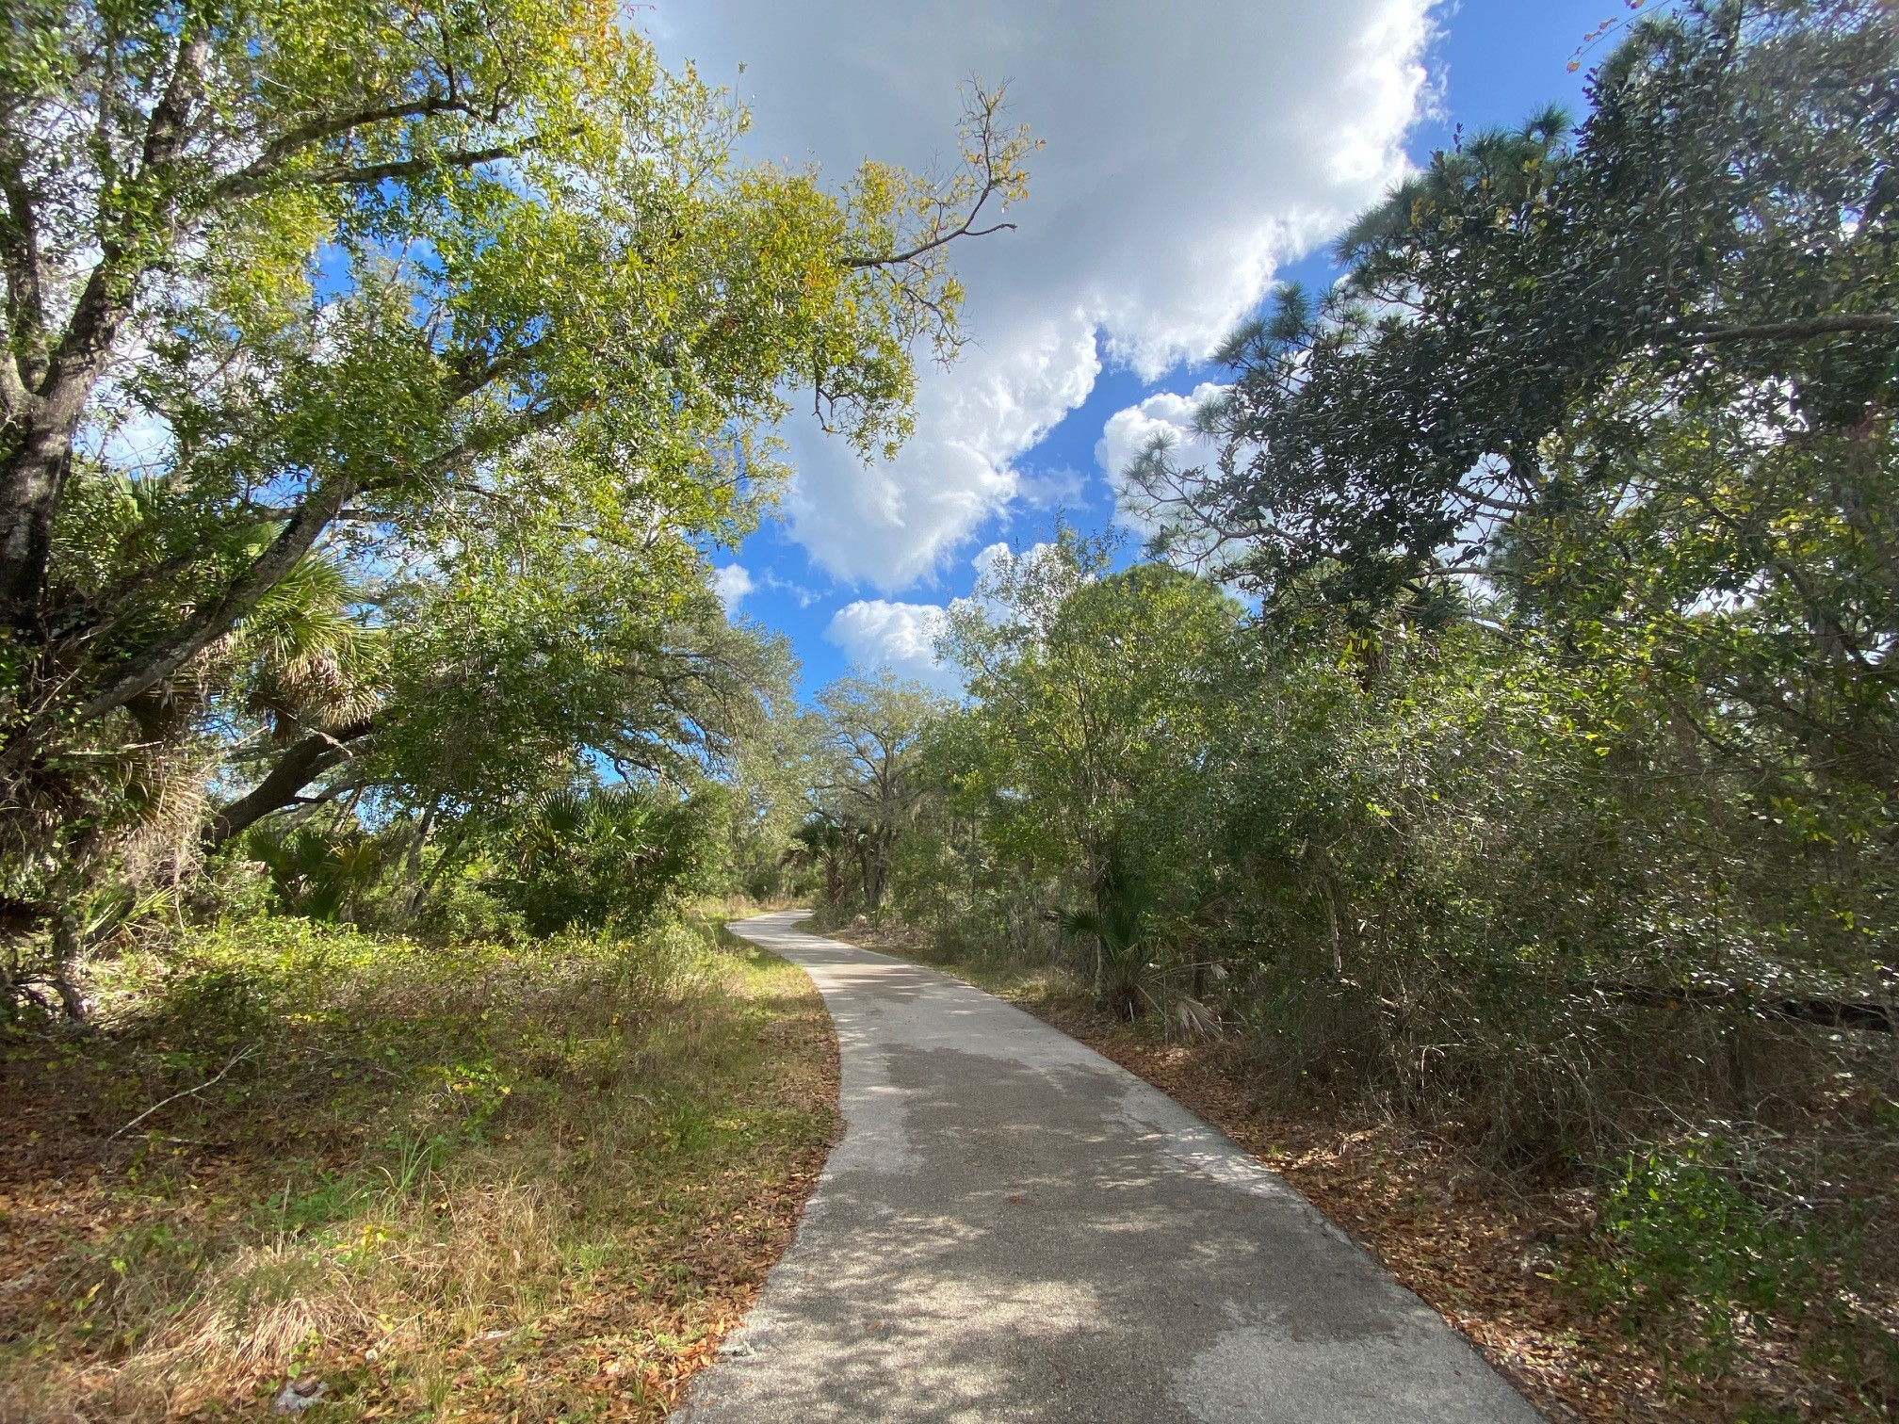
Malabar East
Malabar East Area “D”
Discussion: The Al Tuttle Trail is a Brevard County Showcase project
There are very tall trees on private property, immediately adjacent to the trail to the S
Request the EELp leave ~25’ of trees next to trail to give the illusion of being in the woods, and improve the trail user experience.

Slide 21
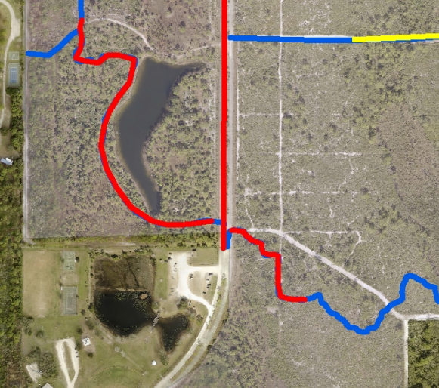
Malabar East
Malabar East Area “E”
Discussion: This is a very large Scrub Oak hammock left as part of the original 2001 restoration compromise. It was specifically left not for trail users, but as a focal point of the main EEL sanctuary entrance, and also enhances the adjacent Malabar Park. Many, many people use this area. Wedding pictures are taken here, bridal showers, pregnancy pictures, trail uses.
Compromise: Request no removal of Scrub Oaks in this area, just removal of sand pines, and possibly tall pine trees, for the following reasons:
This is the Sanctuary main entrance. This is the highlight of the sanctuary. Most trail walkers walk only ~100 yards, and this area gives them an enchanting experience
Used by many people besides trail users
Very Small area overall
Part of the original 2001 compromise
On the property boundary. Not a huge affect to environmental goals. This complex area already has screening trees within 400’ to both the E and S.
Enhances the adjacent Malabar Park
Best area to view various woodpeckers
Scrub Jays often seen on the N part of this area, under the oak canopy
This is the signature area of Malabar East
Keep this massive Oak hammock as simply a beautiful spot used by many
E

Slide 22
Malabar East
Malabar East Area “F”
Discussion: This is an unusual area. Very wet, some pines and sparce palmetto, it will never be good scrub habitat. The lake is a focal point of the sanctuary with mostly walking families and fishermen. This is an ideal location to add a walking trail on the other side of the lake, to allow for a nice local walk for park users. This area must be walked to understand it. There is a large, tall ridge of dirt on the E bank of the lake (spoils from digging the lake – see green line), which screens the area away from the trees to the S-W.
Compromise: Request that minimal restoration be considered here, for the following reasons:
Given the habitat, it does not make sense to us.
Serves as a focal point of the Sanctuary Entrance
Used by may folks other than trail users. A favorite location for fishermen.
Our opinion is additional trail should be added to this area. W lake bank is highly disturbed (piles of dirt left from digging of original lake), and these would be ideal for a top of ridge trail. This ridge provides a screen
Provides a screen of trees from Malabar Park
Provides a screen of trees to adjacent properties
On the property edge
F
VERY
wet

